Slide 1
University of Basra College of medicine The kidney and the urinary tract system Dr. Zainab A. Ameen Iraqi board of histopathology and forensic medicine

Slide 2
Tubulointerstitial Nephritis Induced by Drugs and Toxins The second most common cause of acute kidney injury (after PN) Toxins and drugs injure kidneys in 3 ways: (1) Trigger an interstitial immunologic reaction (2) Acute tubular injury (3) Subclinical but cumulative injury to tubules that takes years to result in chronic renal insufficiency

Slide 3
Acute Drug-Induced Interstitial Nephritis .Occurs with penicillins (methicillin, ampicillin), other antibiotics (rifampin), diuretics (thiazides), NSAIDs, and PPI ( omeprazole) .CF : begins 2 weeks after drug exposure ( fever, eosinophilia , a rash in 25% , hematuria, mild proteinuria, increase in serum creatinine develops in about 50% of cases.

Slide 4
Histology : the interstitium shows frequently pronounced edema and infiltration by mononuclear cells( lymphocytes and macrophages ), eosinophils may be present), with an associated tubular injury Nephropathy Associated with NSAIDs :several forms of renal injury • Acute kidney injury • Acute hypersensitivity interstitial nephritis • Acute interstitial nephritis and minimal-change disease. • Membranous nephropathy

Slide 5
:Urate Nephropathy • Acute uric acid nephropathy precipitation of uric acid crystals in the renal tubules, occur in individuals with leukemias or lymphomas who are undergoing chemotherapy • Chronic urate nephropathy(gout nephropathy) • Nephrolithiasis: uric acid stones

Slide 6
Hypercalcemia and Nephrocalcinosis . Hypercalcemia may induce the formation of calcium stones and deposition of calcium in the kidney (nephrocalcinosis) . Extensive degrees of calcinosis may lead to chronic tubulointerstitial disease and renal insufficiency. . Disorders associated with hypercalcemia 1. hyperparathyroidism 2 .multiple myeloma 3 .vitamin D intoxication 4 .metastatic cancer 5 .excess calcium intake (milk-alkali syndrome)

Slide 7
Renal Vascular Diseases 1. Nephrosclerosis 2. Malignant nephrosclerosis 3. Renal artery stenosis 4. Thrombotic microangipathies 5. Atherosclerotic renal disease 6. Atheroembolic renal disease 7. Sickle cell nephropathy 8. Diffuse cortical necrosis 9. Renal infarction

Slide 8
Nephrosclerosis . Sclerosis of renal arterioles and small arteries and is strongly associated with hypertension .The vascular changes cause ischemia leading to interstitial fibrosis, tubular atrophy and glomerulosclerosis . The frequency and severity of the disease is increased with age , hypertension and diabetes

Slide 9
Morphology . Kidneys are normal or moderately reduced in size, The cortical surfaces have a fine, even granularity that resembles grain leather(subcapsular scars) . Hyaline arteriolosclerosis of arterioles and small arteries ,with fibrous intimal and medial thickening of the arteries.

Slide 10
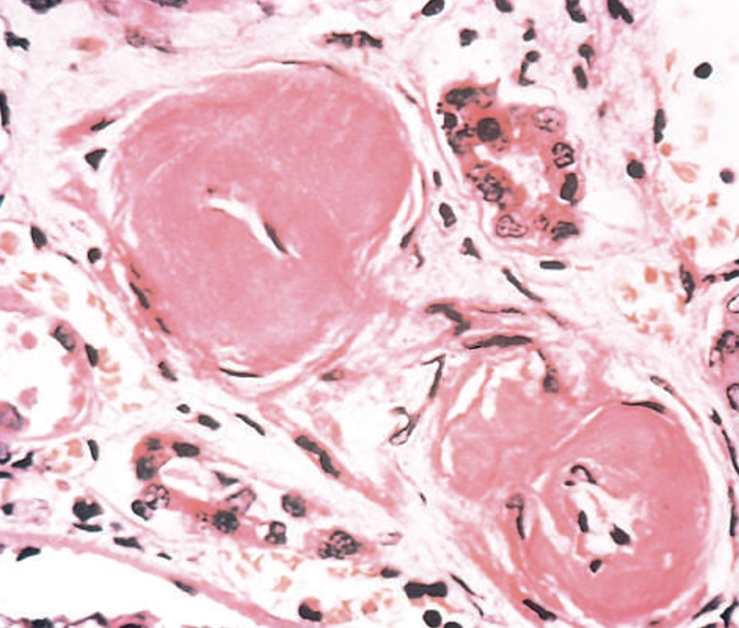
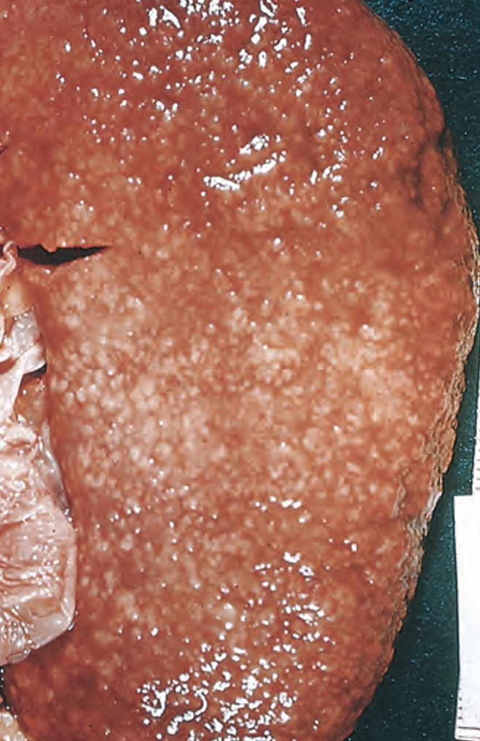
Nephrosclerosis

Slide 11
Malignant Nephrosclerosis . Associated with malignant or accelerated hypertension ,blood Pressure >200/120mmHg . Papilledema, retinal hemorrhages, encephalopathy, cardiovascular abnormalities, and renal failure . The initiating event injures endothelium leading to fibrinoid necrosis of arterioles and small arteries ,activation of platelets and coagulation factors causing intravascular thrombosis , Hyperplastic arteriolosclerosis( hyperplasia of intimal smooth muscle of vessels)

Slide 12
Morphology • Small, pinpoint petechial hemorrhages may appear on the cortical surface giving a“flea-bitten” appearance • Fibrinoid necrosis of arterioles • In the arteries and arterioles, there is onion-skinning - proliferation of elongated, concentrically arranged smooth muscle cells, together with fine concentric layering of collagen (hyperplastic arteriolitis)

Slide 13
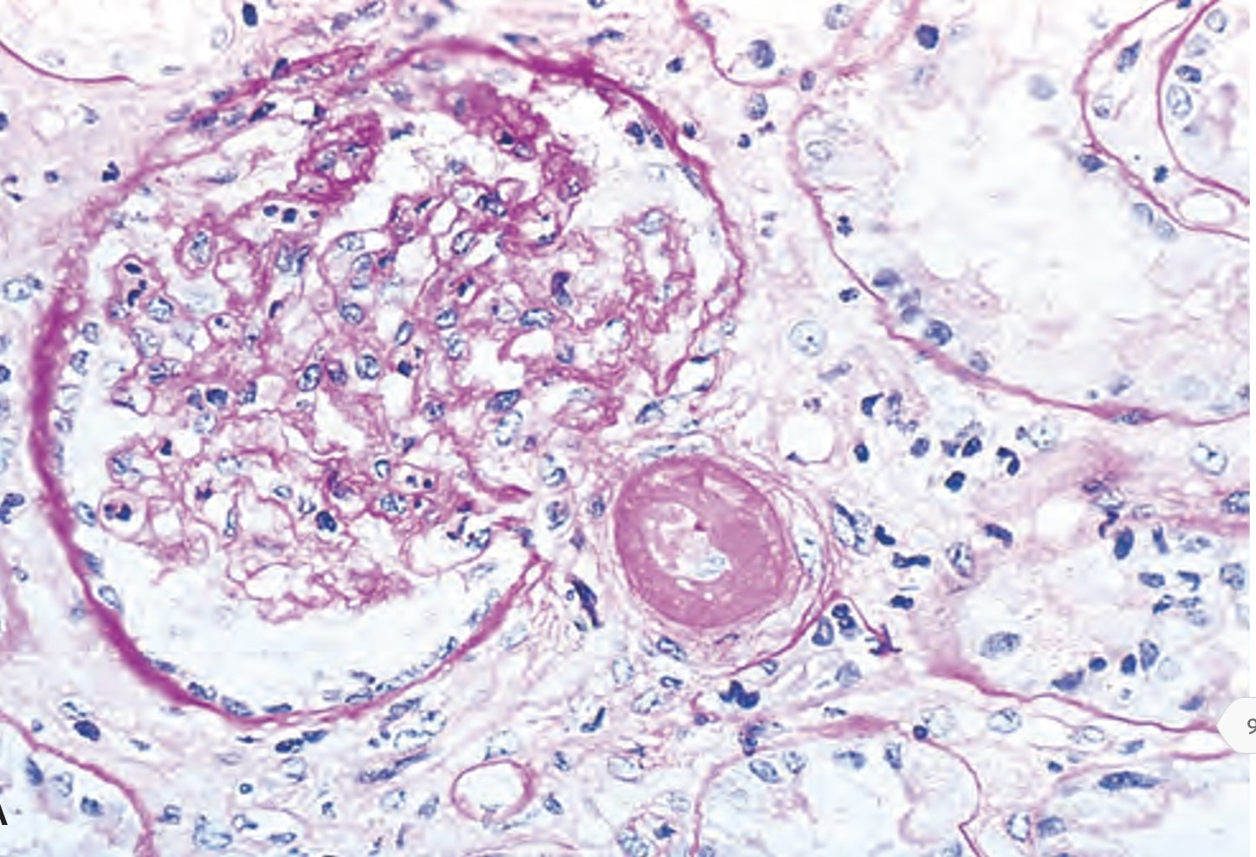
Fibrinoid necrosis of afferent arteriole

Slide 14
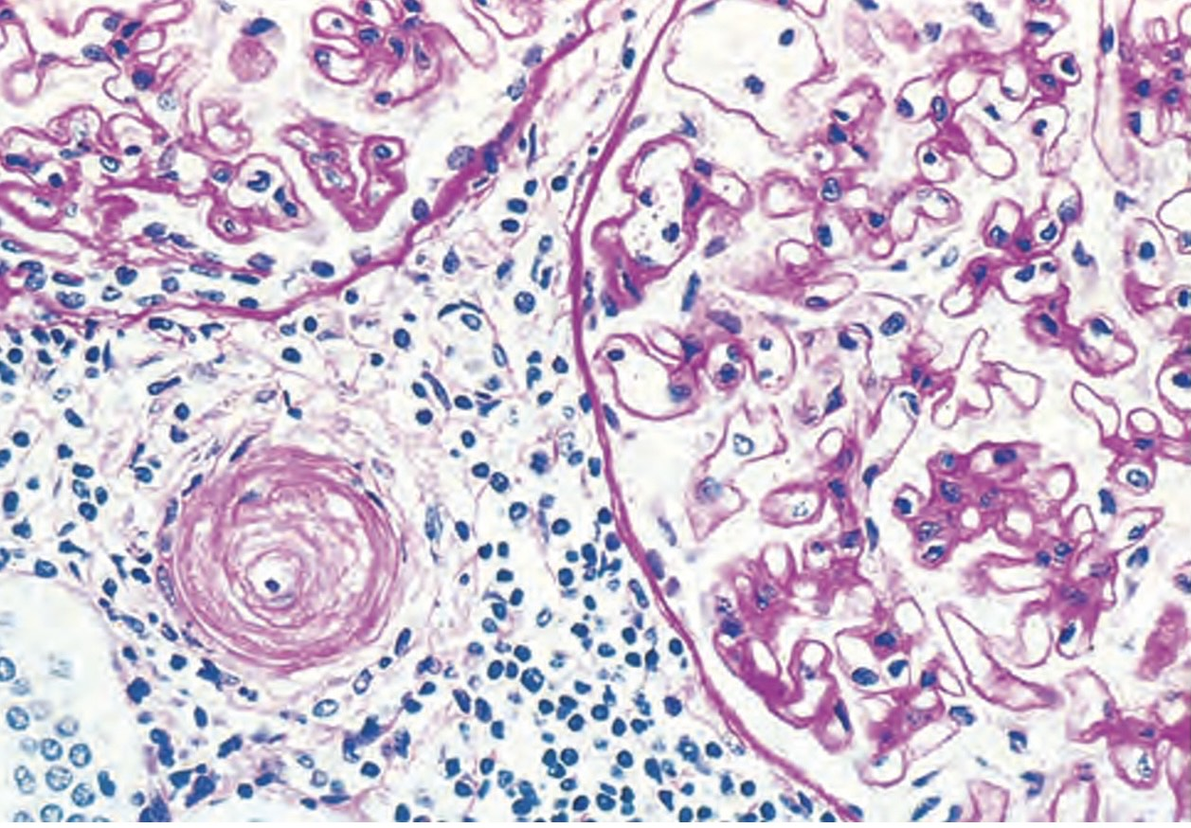
Hyperplastic arteriolitis (onion-skin lesion)

Slide 15
Congenital and Developmental Anomalies . About 10% of people have congenital malformations of the urinary system . Hereditary but most often acquired . All except horseshoe kidney are uncommon

Slide 16
1. Agenesis of the Kidney - Bilateral agenesis is incompatible with life. - Unilateral agenesis is uncommon and compatible with life ,the solitary kidney enlarges as a result of compensatory hypertrophy - It is often associated with other congenital disorders (e.g., limb defects, hypoplastic lungs)

Slide 17
2. Hypoplasia - failure of the kidneys to develop to a normal size - Usually unilateral - Bilateral hypoplastic kidneys will end with Renal Failure

Slide 18
3. Ectopic Kidneys - They lie either just above the pelvic brim or sometimes within the pelvis - Normal or slightly small in size - Because of their abnormal position, kinking or tortuosity of the ureters causing obstruction to urinary flow, predisposes to bacterial infections

Slide 19
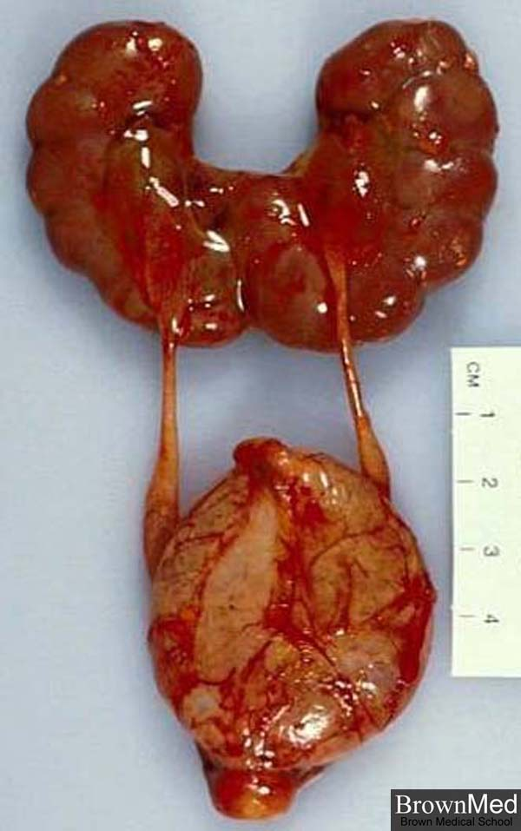
4. Horseshoe Kidneys - The most common congenital kidney anomaly - Fusion of the upper (10%) or lower poles (90%) of the kidneys produces a horseshoe-shaped structure - Found in 1 in 500 to 1000 autopsies

Slide 20
Cystic diseases of the kidneys 1. Hereditary 2. Developmental 3. Acquired :They are important because (1) They are common and often represent diagnostic problems for clinicians, radiologists, and pathologists (2) some forms are major causes of chronic kidney disease (3) they can be confused with malignant tumors

Slide 21
Classification of renal cysts • Polycystic kidney disease - Autosomal dominant (adult) polycystic disease - Autosomal recessive (childhood) polycystic disease • Medullary cystic disease - Medullary sponge kidney - Nephronophthisis • Multicystic renal dysplasia • Acquired (dialysis-associated) cystic disease • Localized (simple) renal cysts • Renal cysts in hereditary malformation syndromes (e.g., tuberous sclerosis)

Slide 22
Adult Polycystic Kidney Disease . Hereditary disorder characterized by multiple expanding cysts of both kidneys that ultimately destroy the renal parenchyma and cause renal failure . It is a common condition and Inherited as autosomal dominant , defective gene(PKD1) on chromosome16 . The kidneys are markedly enlarged with bosselated outer surface , and consist soley of 3-4 cm cysts with no intervening paranchyma, the cysts are composed of fluid(clear , turbid or hemorrhagic)

Slide 23
Clinical features . Usually asymptomatic until the 4th decade of life, present as flank pain , intermittent gross hematuria, hypertension in 75% . Associated saccular aneurysm of the circle of willis (10-30%). . The disease progress slowly to end stage renal disease by the age 50

Slide 24
Morphology . Saccular expansion of all portions of renal tubule . Cysts are lined by cuboidal or flattened epithelium . Functional nephrons are found between the cysts with areas of global sclerosis, tubular atrophy , interstitial fibrosis and chronic inflammation

Slide 25
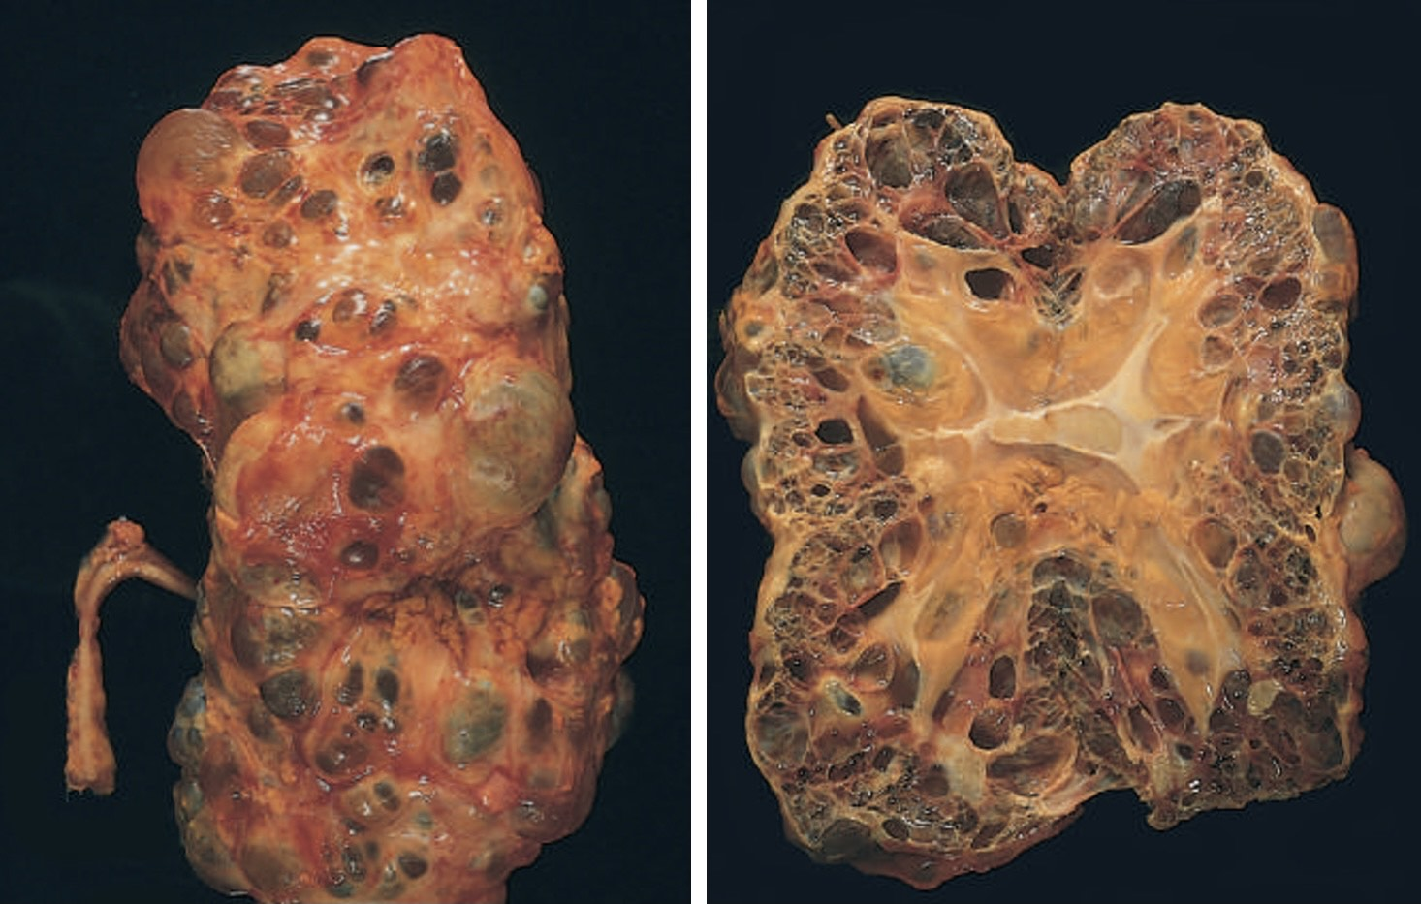
Adult Polycystic Kidney Disease

Slide 26
Childhood Polycystic Kidney Disease . Rare autosomal recessive disorder result from PKHD1 gene mutation on chromosome 6 . Subdivided to perinatal, neonatal, infantile and juvenile types . Numerous small cortical and medullary cysts give the kidney sponge like appearance . It is always bilateral and associated with hepatic cysts .

Slide 27
Morphology . The kidneys are enlarged and have a smooth external appearance. On C/S : numerous small cysts in the cortex and medulla give the kidney a spongelike appearance . L.M: there is cylindrical or saccular dilation of all collecting tubules with uniform lining of cuboidal cells

Slide 28
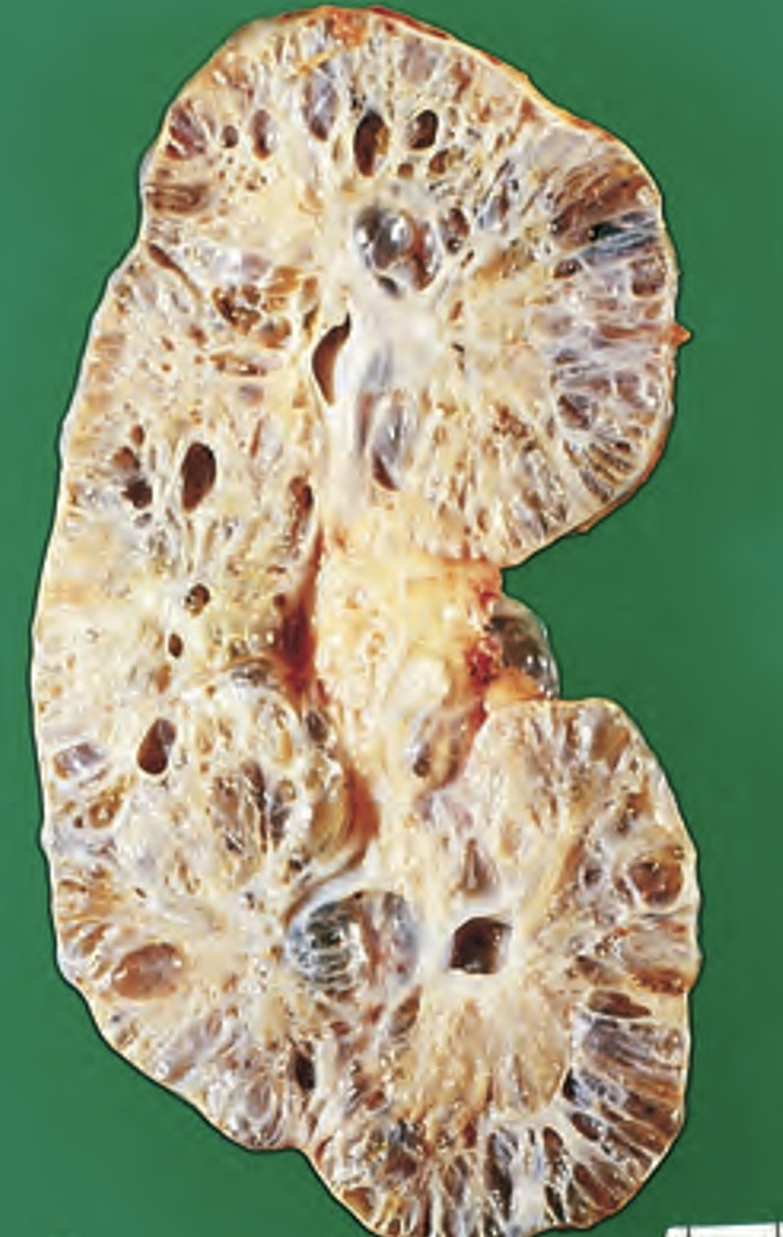
Childhood Polycystic Kidney Disease

Slide 29
Cystic diseases of renal medulla :1. Medullary cystic disease .Common and innocuous . Small multiple cystic dilations of the collecting ducts in the medulla and corticomedullary junction. . Occurs in adults and is discovered accidently . Renal function is normal . The cysts are lined by cuboidal epithelium . The pathogenesis is unknown.

Slide 30
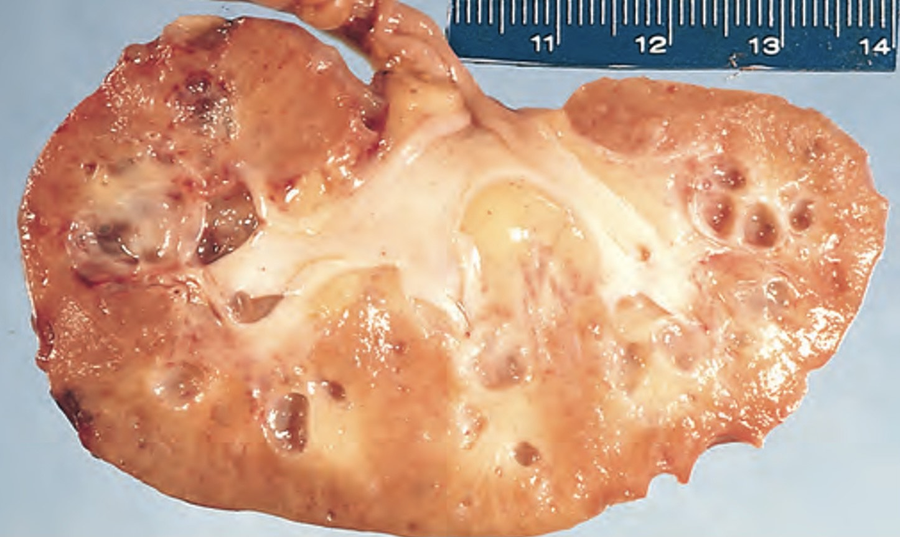
Medullary cystic disease

Slide 31
2.Nephronophthisis –medullary cystic disease complex: . AR . Significant cause of CKD . Usually begins in childhood . 4 subtypes(infantile, juvenile,adolescent and adult ) . Juvenile form is most common and associated with retinal abnormalities . Morphology: small contracted kidneys with numerous small medullary cysts lined by flattened epithelium

Slide 32
Simple cyst . Very common . Single or multiple . 1-5 cm in size . Translucent membrane and filled with clear fluid . Lined by cuboidal or flattened epithelium . Asymptomatic and discovered accidently

Slide 33
Acquired (dialysis – associated) cystic disease . End stage renal disease with prolonged dialysis . Numerous cortical and medullary cysts . 1-4 cm in size with clear fluid . Lined by hyperplastic or flattened tubular epithelium . Mostly asymptomatic . 12-18 folds increased risk of RCC

Slide 34
Urinary Tract Obstruction (Obstructive Uropathy) . Sudden or insidious . Partial or complete . unilateral or bilateral . Occur at any level of the urinary tract from the urethra to the renal pelvis . Increase susceptibility to infection, stone formation and hydronephrosis . Unrelieved obstruction almost always leads to permanent renal atrophy

Slide 35
Common causes of urinary tract obstruction: 1. congenital anomalies - posterior urethral valves and urethral strictures - meatal stenosis - bladder neck obstruction - ureteropelvic junction narrowing or obstruction - severe vesicoureteral reflux 2 .Urinary calculi 3. Benign prostatic hypertrophy 4. Tumors: carcinoma of the prostate, bladder tumors, carcinoma of the cervix or uterus

Slide 36
5. Inflammation: prostatitis, ureteritis, urethritis, retroperitoneal fibrosis 6. Sloughed papillae or blood clots 7. Pregnancy 8. Uterine prolapse 9. Functional disorders

Slide 37
Hydronephrosis . Dilation of the renal pelvis and calyces associated with progressive atrophy of the kidney due to obstruction to the outflow of urine . Bilateral HN occurs only when the obstruction is below the level of the ureters . Mostly partial

Slide 38
Clinical features - Acute obstruction may provoke pain - Unilateral complete or partial hydronephrosis may remain silent for long periods - Complete bilateral obstruction of rapid onset results in oliguria or anuria and is incompatible with survival unless the obstruction is relieved

Slide 39
Morphology Grossly the kidney is massively enlarged(up to 20 cm),renal paranchyma is compressed and atrophied Microscopy - Early lesions : tubular dilation, followed by atrophy and fibrous replacement of the tubular epithelium with sparing of the glomeruli - sever cases: the glomeruli become atrophic and disappear converting the entire kidney into thin fibrous shell

Slide 40
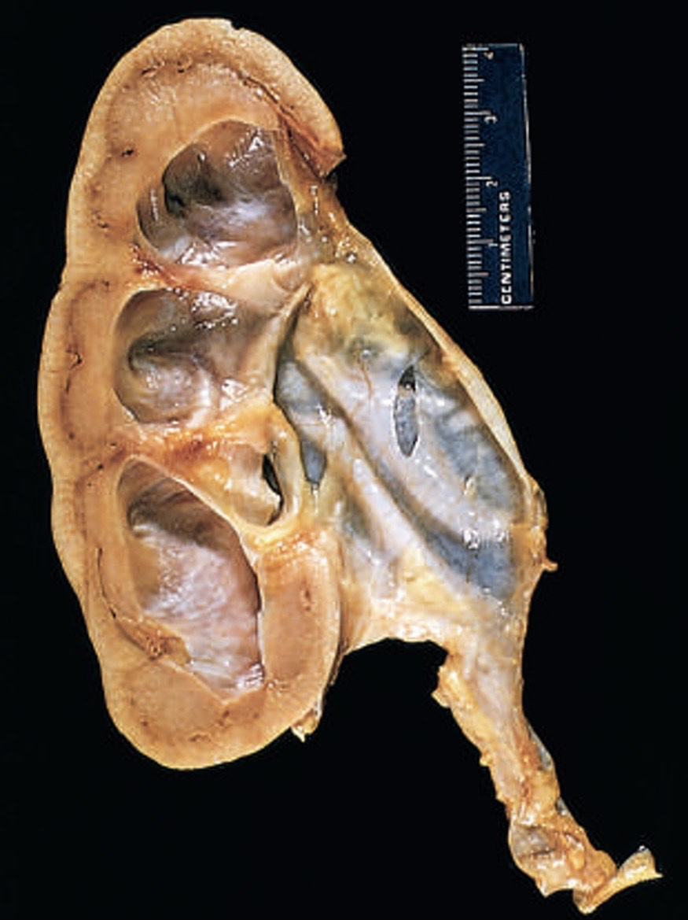
Hydronphrosis

Slide 41
Urolithiasis (Renal Calculi, Stones) . Uilateral in 80% . They can occur at any level of urinary tract, but mostly occur in the kidney. . Male >Female. . Types: According to the constituents of stones, can be classified into: 1. Calcium stone 80%. 2. Triple phosphate ( Struvite ) stone 10 %. 3. Uric acid stone 6-7%. 4. Cystine stone 1-2%.

Slide 42
1. Calcium oxalate stones . Calcium oxalate or calcium oxalate mixed with calcium phosphate . Hypercalcemia and hypercalciuria: - hyperparathyroidism - diffuse bone disease - sarcoidosis . 50% have hypercalciuria without hypercalcemia : - absorptive hypercalciuria - renal hypercalciuria . Radio-opaque . Acidic urine

Slide 43
2. Magnesium ammonium phosphate stone (struvite stone) - Alkaline urine resulting from UTI - Urea splitting bacteria: proteus vulgaris and some staphylococci - Radio-opaque - Staghorn stones : Large branching stones

Slide 44
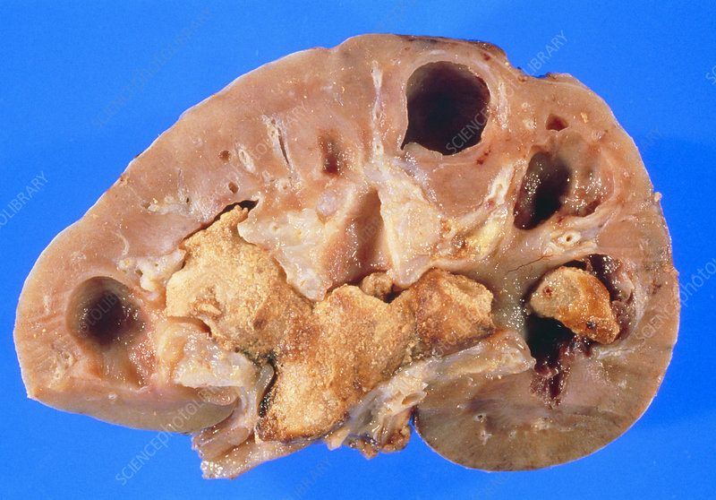
Staghorn stone

Slide 45
3.Uric acid stones - Common in hyperuricemia such as gout and rapid cell turn over diseases - Radiolucent stones - Acidic urine 4 .Cystine stones - They occur due to genetic defect in the renal transport of amino acid like cystine - Acidic urine.

